Slide 1

Ezhil : Beautifying the Temple City Through Civic Tech
Empowering citizens to report, clean, and monitor waste using AI
TEAM NAME: WAKANDA

Slide 2
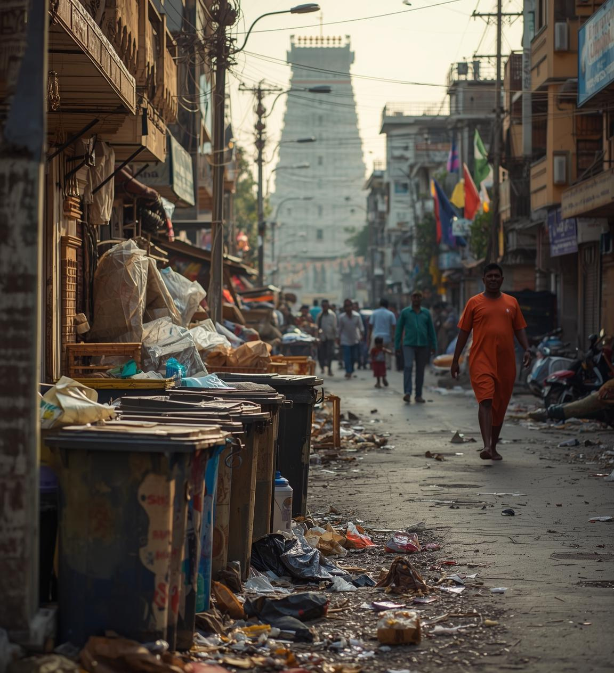
Waste Management Challenges in Madurai
Madurai faces significant issues with urban waste, resulting in clogged streets and health hazards. Effective civic engagement and technology-driven solutions are essential to improve cleanliness and environmental sustainability.

Slide 3

Problem Statement
Key challenges affecting waste management
Citizen Engagement
Waste Classification
Complaint Generation
There is limited involvement from residents in reporting waste issues, which hampers the overall effectiveness of civic cleanliness initiatives and results in unaddressed waste problems.
Current reporting apps lack intelligent classification capabilities, making it difficult to categorize waste types effectively and leading to inefficient responses from authorities.
The manual generation of complaints creates inefficiencies in tracking and addressing waste issues, resulting in delays and inadequate responses to citizens' concerns.
3

Slide 4
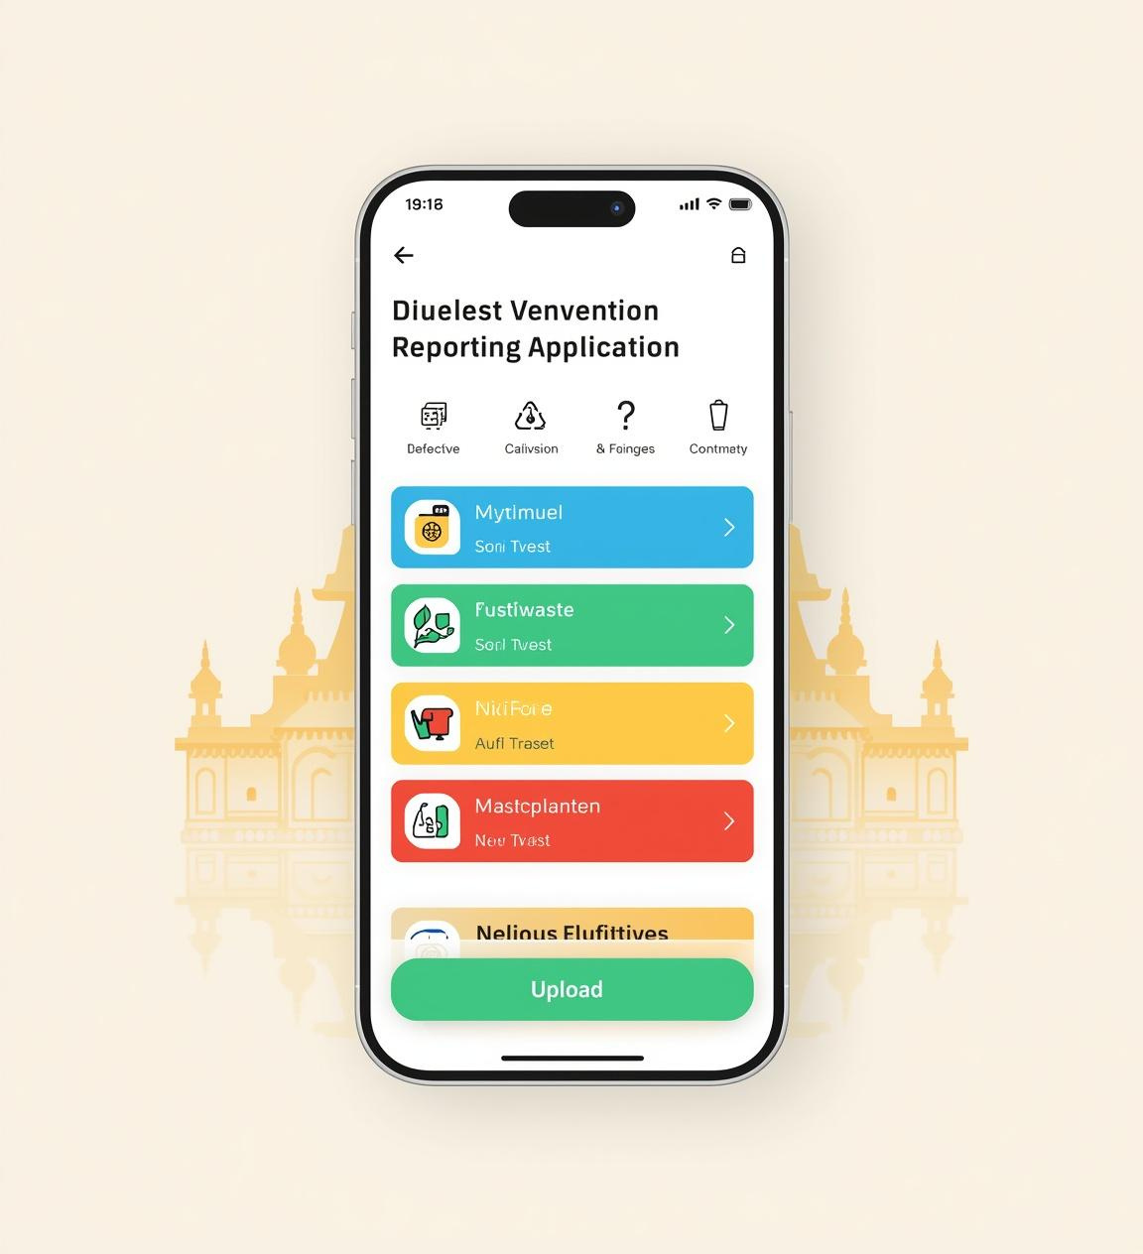
Introducing Build Ezhil
Build Ezhil is a mobile-first web app designed for easy waste image uploads, using AI for classification and creating an intuitive platform for real-time cleanliness monitoring in Madurai neighborhoods.

Slide 5
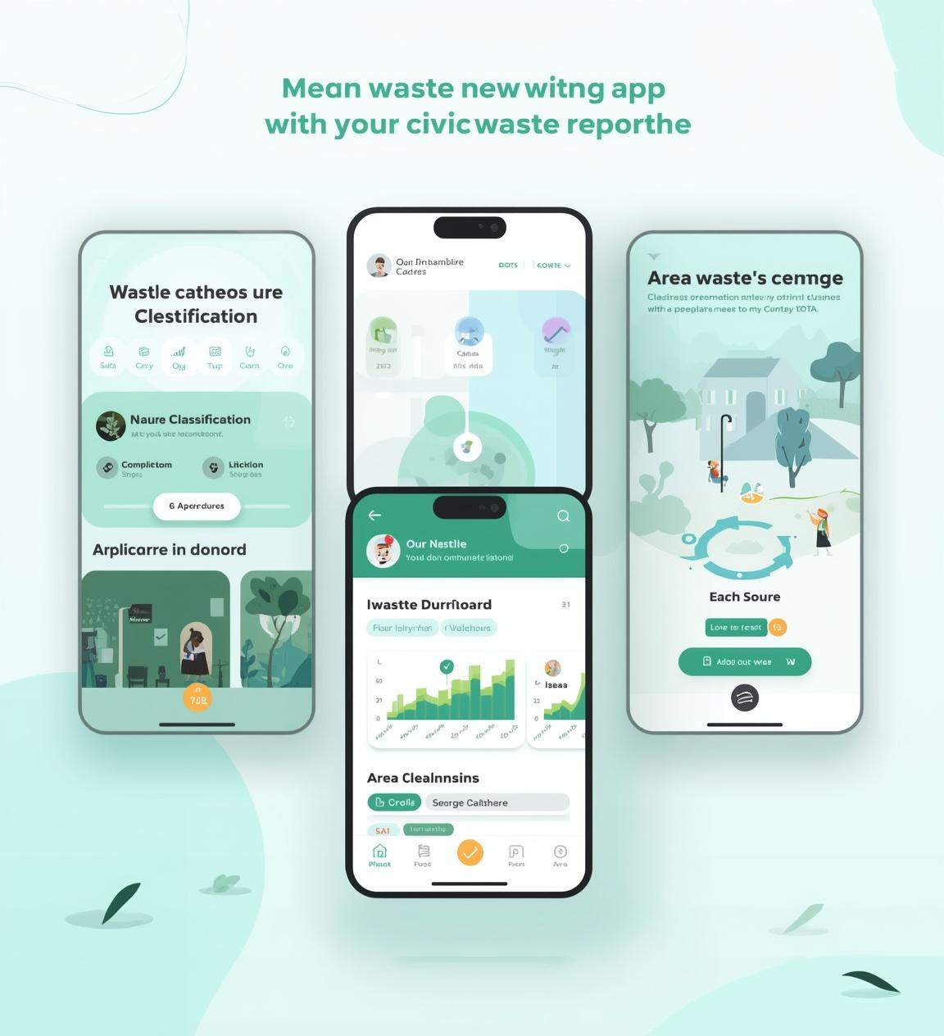
Core Features of Build Ezhil
AI waste classification for accurate disposal guidance
Auto-generated complaints submitted directly to authorities
Real-time area dashboard displaying cleanliness metrics

Slide 6
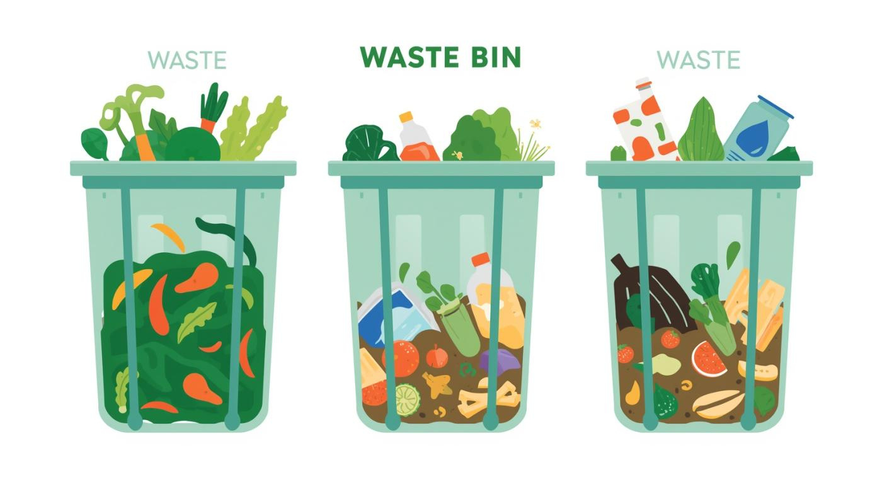

AI-Powered Waste Classification: Wet and Dry

Slide 7


AI Waste Classification: Hazardous & Mixed

Slide 8
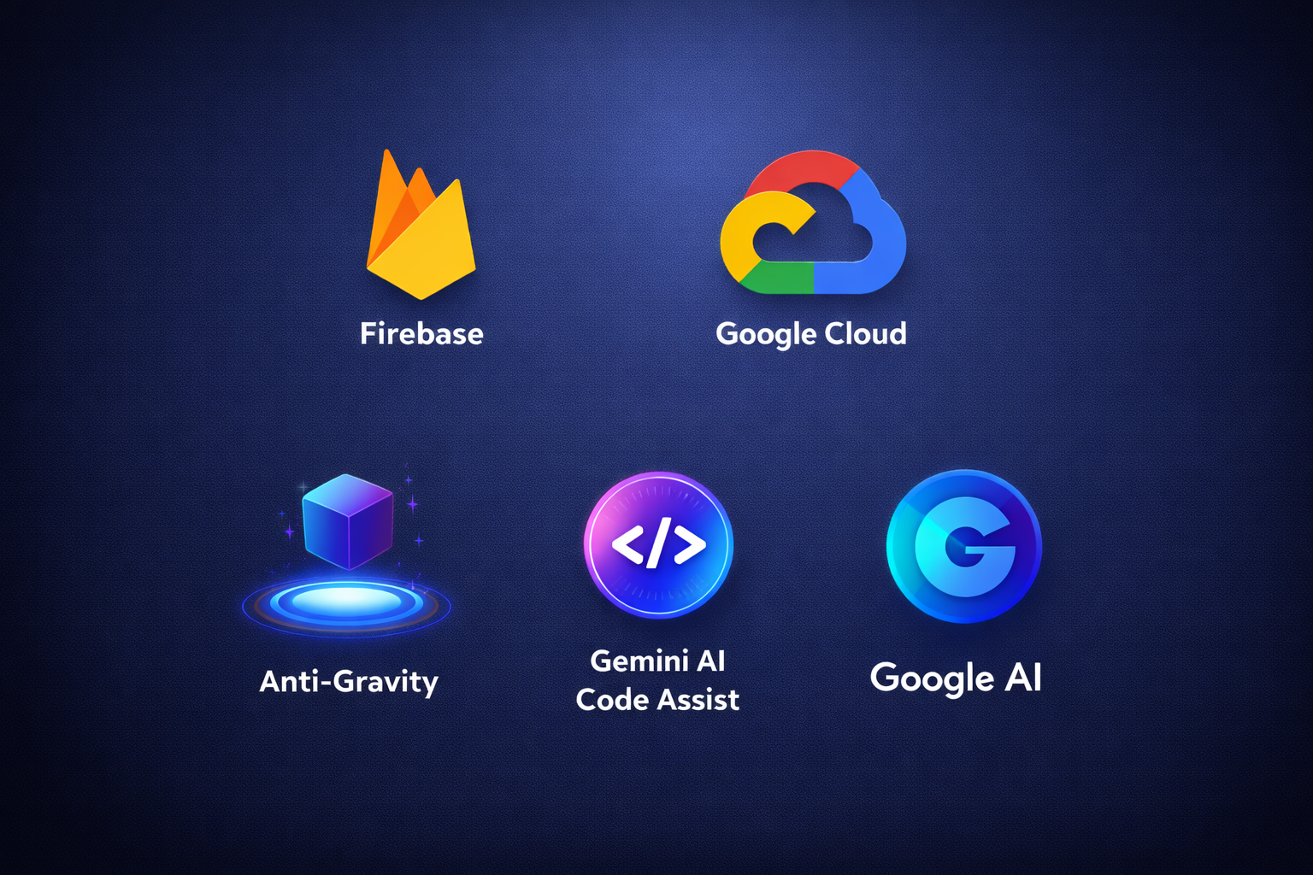
Scalable Architecture and Technology Stack
Build Ezhil utilizes a Progressive Web App (PWA) framework, integrating Gemini AI models for waste classification and Firebase for secure data management. This architecture supports real-time updates and efficient civic engagement.

Slide 9
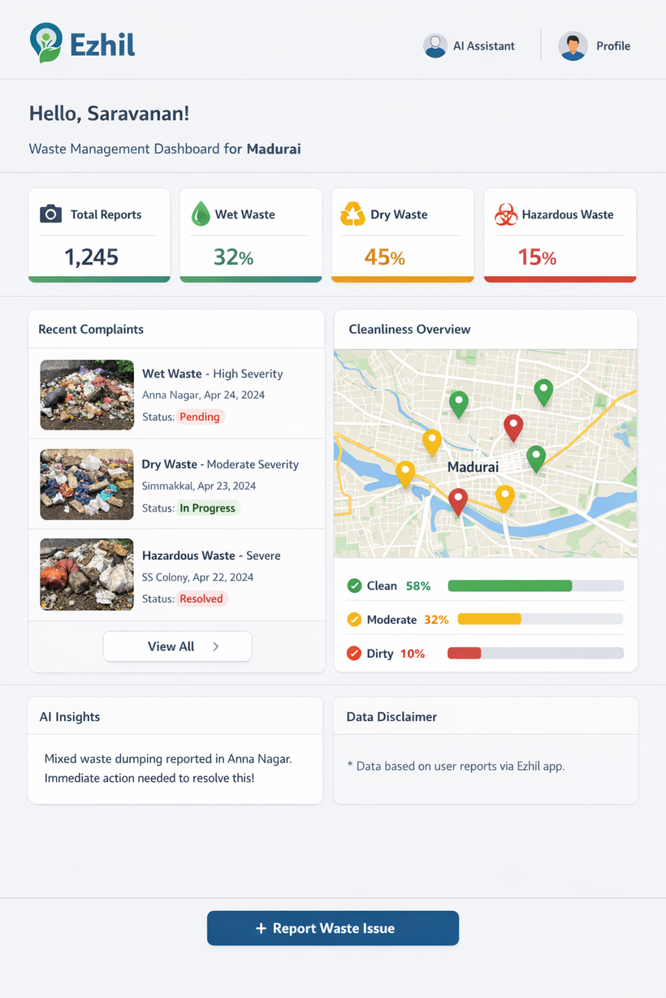
Real-Time Cleanliness Metrics
Visualizing waste management insights in real-time
The dashboard provides citizens and authorities with instant insights into area cleanliness, enabling timely actions based on user reports and fostering a cleaner Madurai for all.

Slide 10
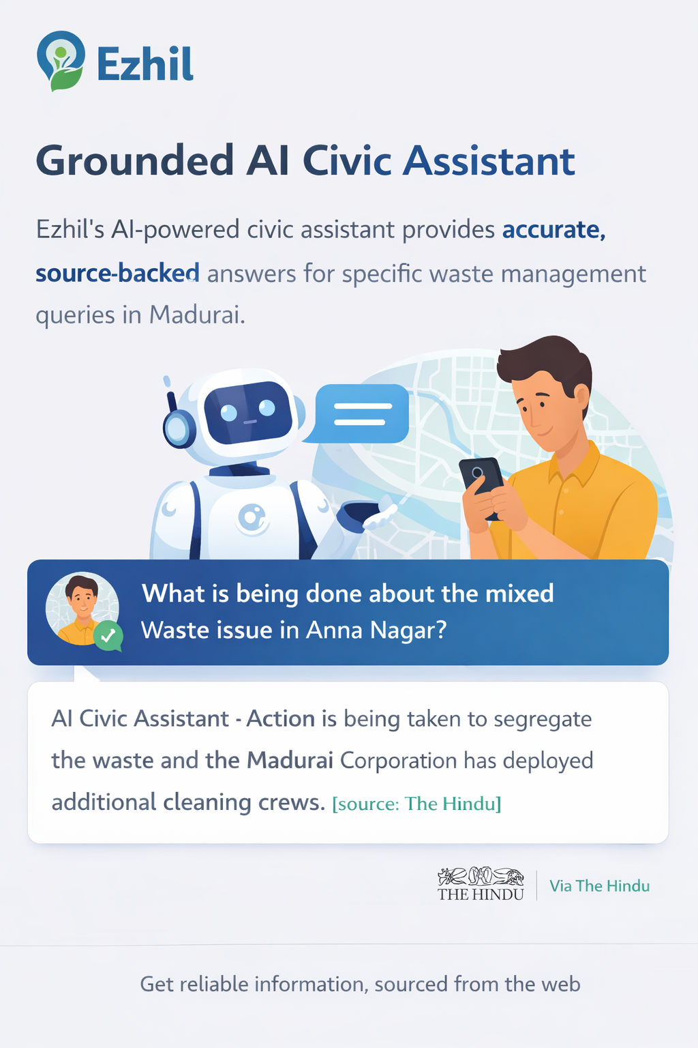
Grounded AI Civic Assistant
Our AI assistant provides reliable answers to citizen inquiries about waste disposal and civic services. By linking responses to credible sources, it fosters user trust and encourages community engagement in sustainability efforts.

Slide 11

Ensuring integrity and user trust
At Build Ezhil, we prioritize data integrity and transparency:
No fabricated statistics or misleading information
Clear disclosure of AI confidence levels and limitations
Robust user data privacy measures with secure Firebase storage
Commitment to open and trustworthy civic technology
By adhering to these principles, we aim to foster user trust and create a reliable platform for civic engagement. Our approach not only enhances the functionality of the app but also ensures that citizens feel confident in utilizing the services offered by the platform.

